Slide 1
Microservices in MY test framework?
It’s more likely than you think

Slide 2
Who am I?
Automation Architect at HomeAdvisor
15 or 20 years of experience in software test engineering
Co-Host of the West Denver Test Engineering Meetup
A mix between the Dopey and Sleepy dwarfs
Happy to be here
More bullet points is more impressive right?

Slide 3
Something to think about
What is being done in Software Engineering today, will be implemented in Software Test Engineering 3 years from now
Is this statement true for you?

Slide 4
What is SOA and what is a microservice?
SOA (Service Oriented Architecture)- A means of separating out business components and logic into self-contained stateless services
Practically ancient by today’s modern application standards
Microservices – independently deployable small modular services
Each service has a distinct job and well-defined contract for communicating with it
Also stateless
Stateless?
It has no memory of what came before and no assumptions about what will come after

Slide 5
How I will be using the term SOA incorrectly
Typically SOA refers to websites with heavy relational databases and shared resources
Microservices can be seen as the next step forward in application design.
Taking the concepts of SOA and improving them.
Using NoSql or small targeted databases
For today’s talk though SOA & Microservice just mean custom internal test APIs to be used across the entire test strategy
From UI to API to Performance to Manual

Slide 6
Sharing: A quick look at some problems you might have faced
Sharing code with developers
Maybe your test framework is in a different language or in a format more easily consumed by you and your tools than them
Sharing code between test frameworks
Being able to share code, especially around data management, between your API and UI frameworks might require creating multiple repos or modules to be shared
Can lead to version hell
Sharing functionality with manual testers and product people
Often leads to many many many Jenkins jobs
Or documents riddled with bullet points

Slide 7
Data Management: another quick look
Having environmental issues means data creation fails intermittently
Data creation works but requires numerous API requests and/or DB queries to work
Site is configured or built in a way that the only way to create data is through the UI
API’s don’t exist to give you the picture you need
There’s an API to get A user but not ALL users

Slide 8
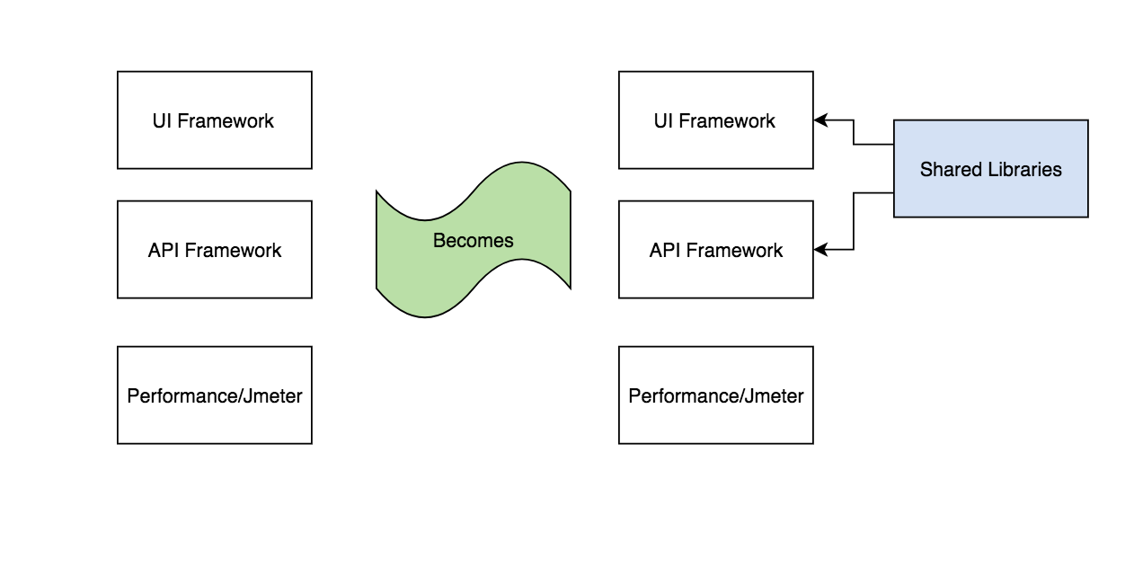
Evolution of a framework

Slide 9
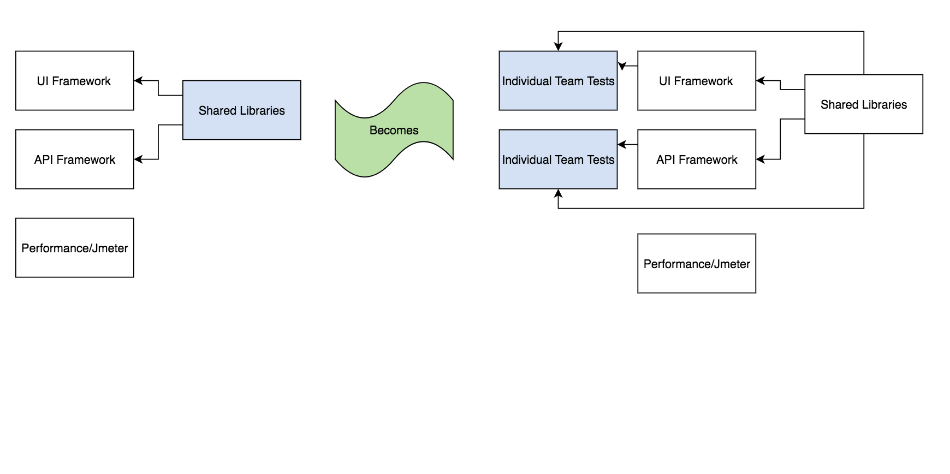
Evolution of a framework

Slide 10
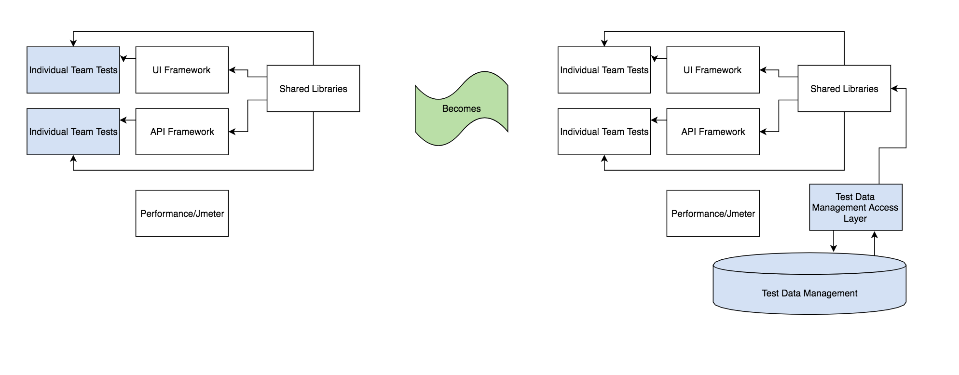
Evolution of a framework

Slide 11
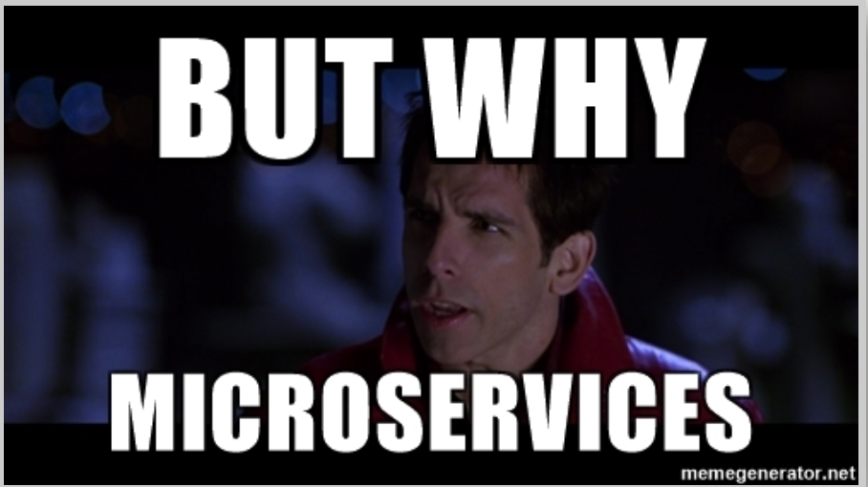
So why microservices?
Language agnostic functional placeholders
Easily deployable
Docker
Easy to access and use
REST API
Simplify complex actions
Test data creation made easy

Slide 12
Key tenets of successful automation
Easy to use/adopt
Effectiveness/Coverage
Speed of Execution
Consistency
Clarity of Results
Easily discoverable and consistent documentation

Slide 13
How microservice/SOA can help
Easy to Use/Adopt
What’s easier than hitting a url/endpoint?
Speed of Execution
Test data management allows for simplified setup/teardown
Consistency
Staged data can smooth out bumpy environments
Easily discoverable consistent documentation
Tools like Swagger/Zookeeper allow for self-documenting, discoverable applications
Effectiveness/Coverage
No promises here
Clarity of Results
No solution can promise everything

Slide 14
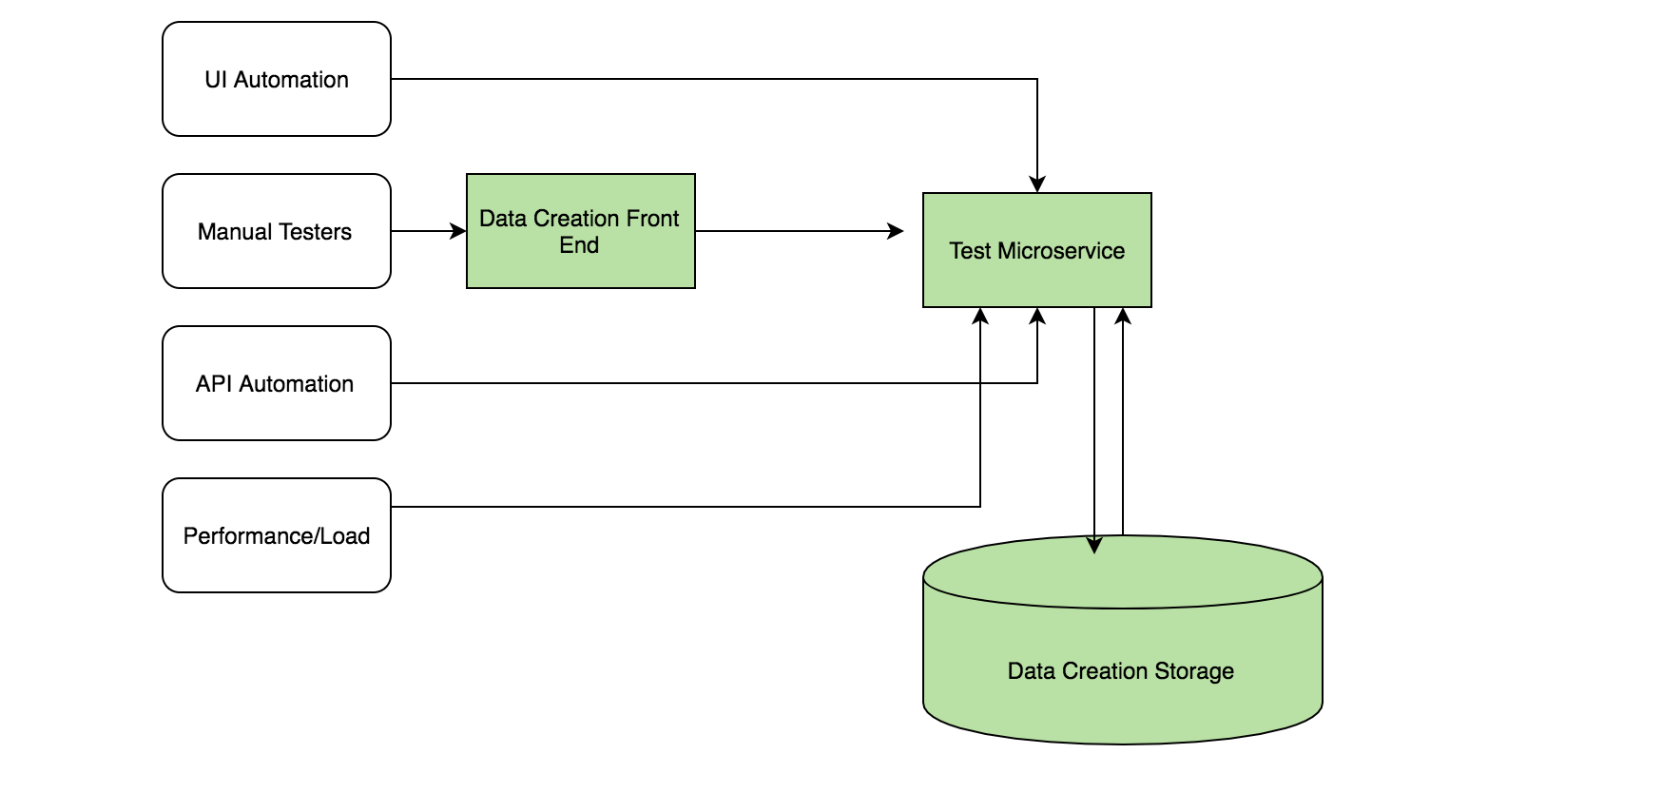
Integrating microservices into your test strategy

Slide 15
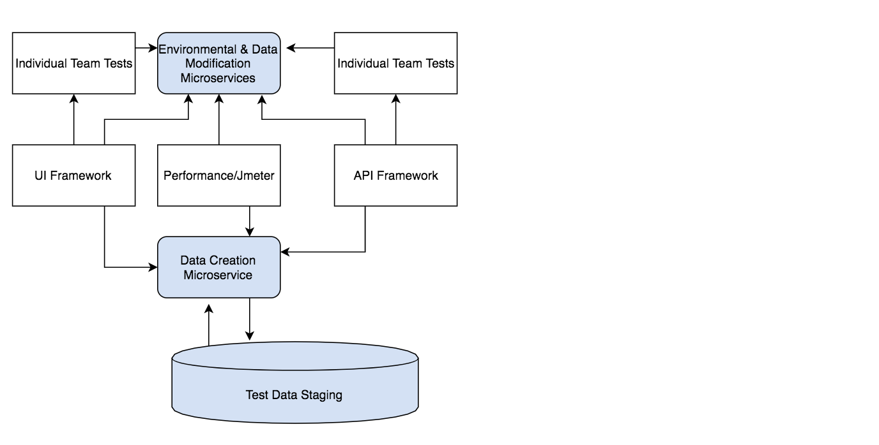
A slightly more detailed implementation

Slide 16
Well that doesn’t seem simpler at all
At first glance complexity seems to have grown
Consider deployment and versioning
If contract isn’t broken new code can be deployed and immediately consumed
New versions can be built into the REST endpoint
Docker and Jenkins can be used to create your own deployment pipeline
Your pool of consumers has swelled
Other Automation Engineers
Manual Testers
Developers
Product Managers

Slide 17
Some example endpoints
Simplified user creation
GET /env/qa/createUser?userType=internal
More complex creation builds off earlier endpoints
GET /env/dev/createWidget?widgetType=thing&userType=internal
Each layer can call previous endpoints or reuse the same shared code
Staged data
GET /env/prod/pool/stagedHardToCreateData/entry
Transformational
GET /env/staging/user/{userId}/updateState?state=deactivated
Abstracted data retrieval
GET /env/qa/retrieveData?dataParameter=value&optionalQueryParameter=otherValue

Slide 18
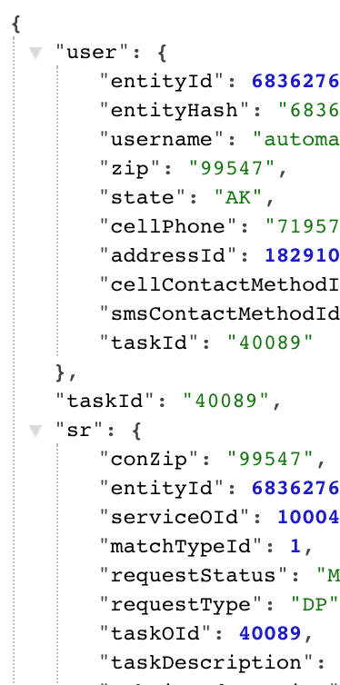
Some sample data
Results are returned in easily parseable JSON
Or whatever format you prefer
Use java serialization/deserialization to create immediate objects
Using NoSql DBs like Mongo
Allow for near limitless storage opportunities

Slide 19

We may have to break a few rules along the way
We use GETs to make consumption easier for manual testers/product managers
We use more explicit naming and path construction
Your mileage may vary

Slide 20
Automation lives and dies by its data
Being able to dynamically and quickly create test data is key
Staged data can allow tests to “jump” over nonessential functionality for the test
Allowing for highly targeted tests and clearer picture of overall application quality
Being able to hit a bookmark and have immediate data with all relevant information is invaluable
For more fun create your own simple UI to store all data creation options

Slide 21
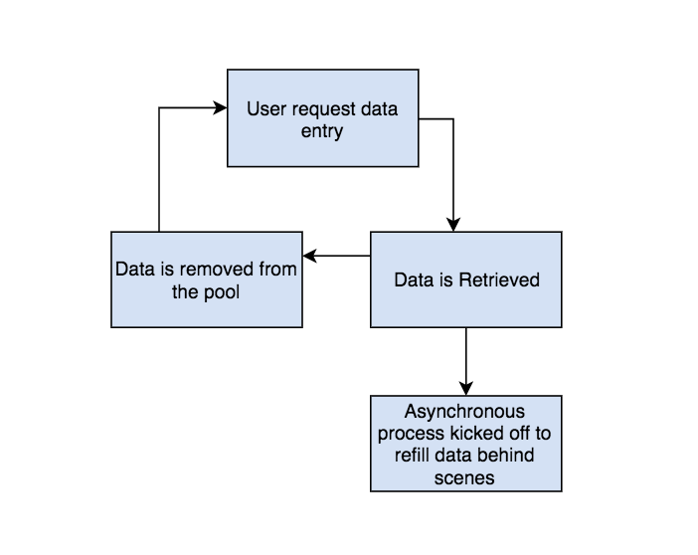
Data pooling logic
Just a queue of JSON objects
Request returns the top entry
Asynchronous process refills data
RabbitMq if you’re fancy

Slide 22
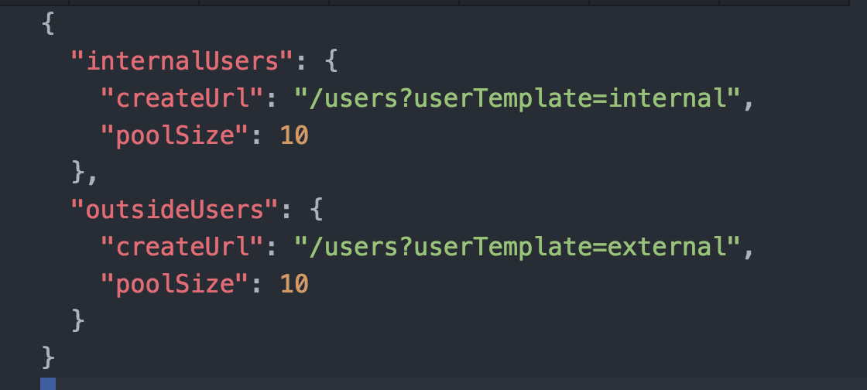
Pool configuration is simple
Just a URL and a size
Pool creation/configuration can be its own API/UI

Slide 23
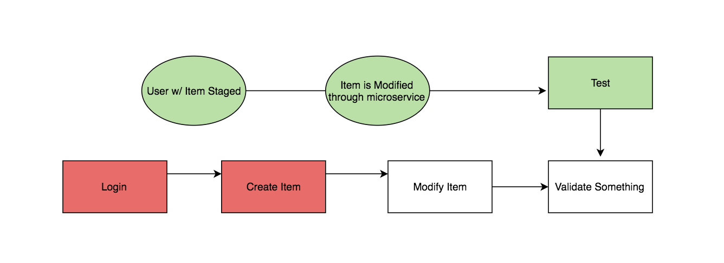
What data staging buys you
Able to performance test difficult data destroying endpoints like deletes
Broken functionality in environment does not prevent ALL tests from running

Slide 24
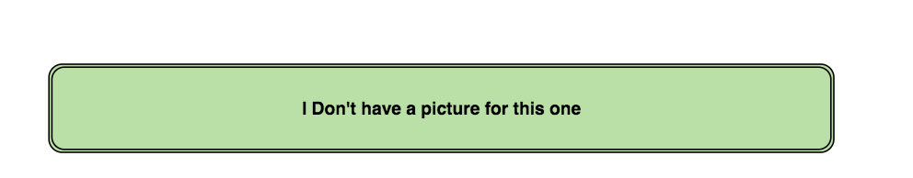
Abstracting away complexities
Some actions may require multiple API calls and DB interactions
Single endpoint can run any number of steps and be configurable through path/query parameters in a readable fashion
Interacting with the DB can be painful :cough:oracle:cough:
A single server only needs access to the DB and everything else retrieves data through that access layer
Companies may want to severely restrict access to DB
Microservice server can be locked down preventing misuse
All queries & endpoints can be vetted

Slide 25
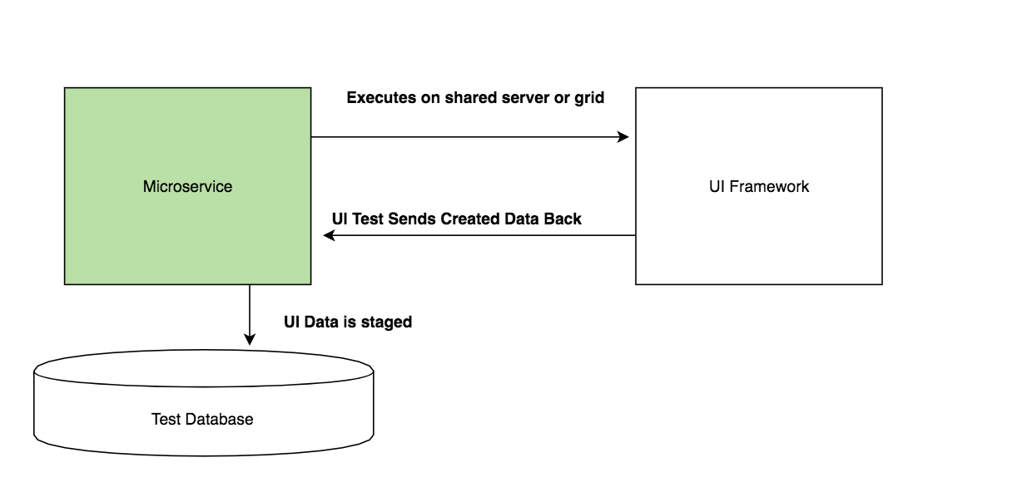
Even the lowly UI test can join the fun
Sometimes UI is the only way
Tests can be configured to call microservice on completion
Better yet PhantomJs or other headless browsers
Microservice executes the test/UI interaction on demand

Slide 26
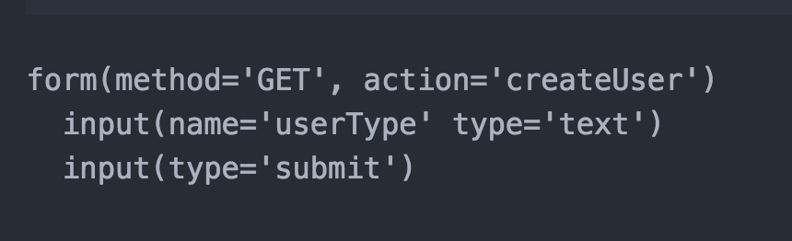
Throw it all behind a UI
Templating agents like Jade/Pug, Sinatra and Django make simple UI creation easy
Throw a quick form together to allow anyone to create any data they need

Slide 27
Now for the implementation
Everything in the demo is available for you to pull down and start using!
https://github.com/mustarddemon/microservice-demo
Install nodejs, clone and run npm install to start working!
We are going to use NodeJs for a couple reasons
All languages have easy to setup web servers that can be spun up quickly
We are going to use Mongo
Great for prototyping and internal tools
Just an easy collection of piles to store your crap in

Slide 28
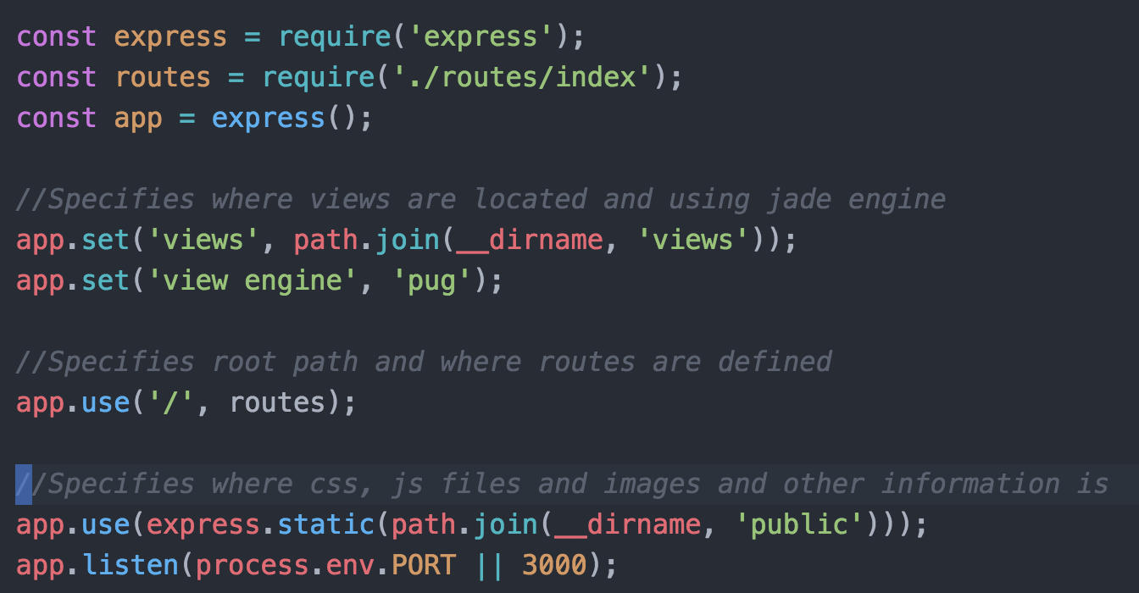
Creating the server
New server can be spun up in 5 minutes
This is a server with a routes file and a built in template agent ready to use

Slide 29
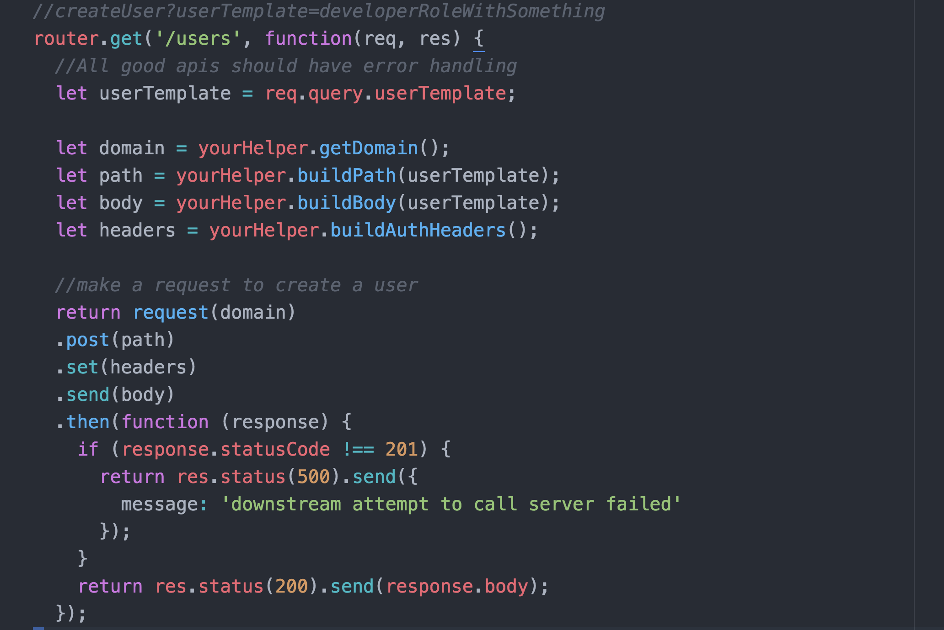
Create our first abstraction endpoint – (simplified)

Slide 30
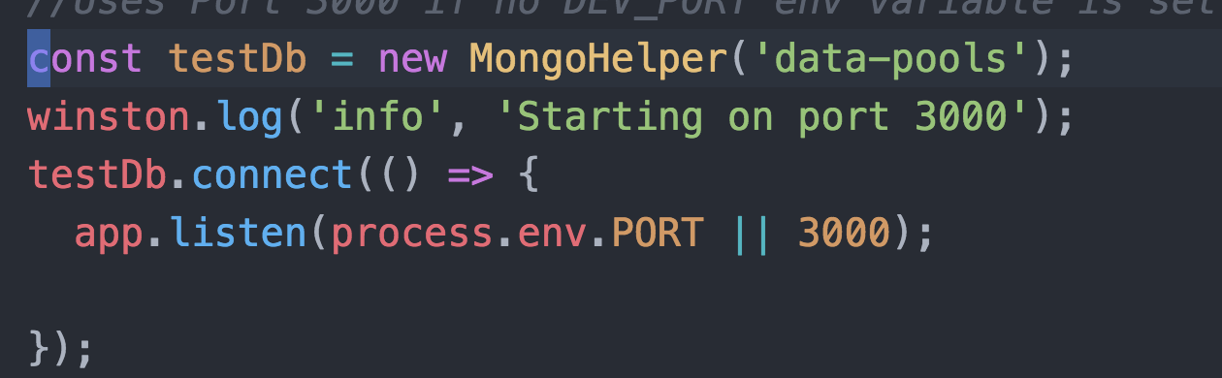
Simplify Mongo DB access
We have a simple Mongo Helper that facilitates connection and basic actions in the ./server/lib/mongo_helper.js check it out!
Update the server to connect to mongo when starting

Slide 31
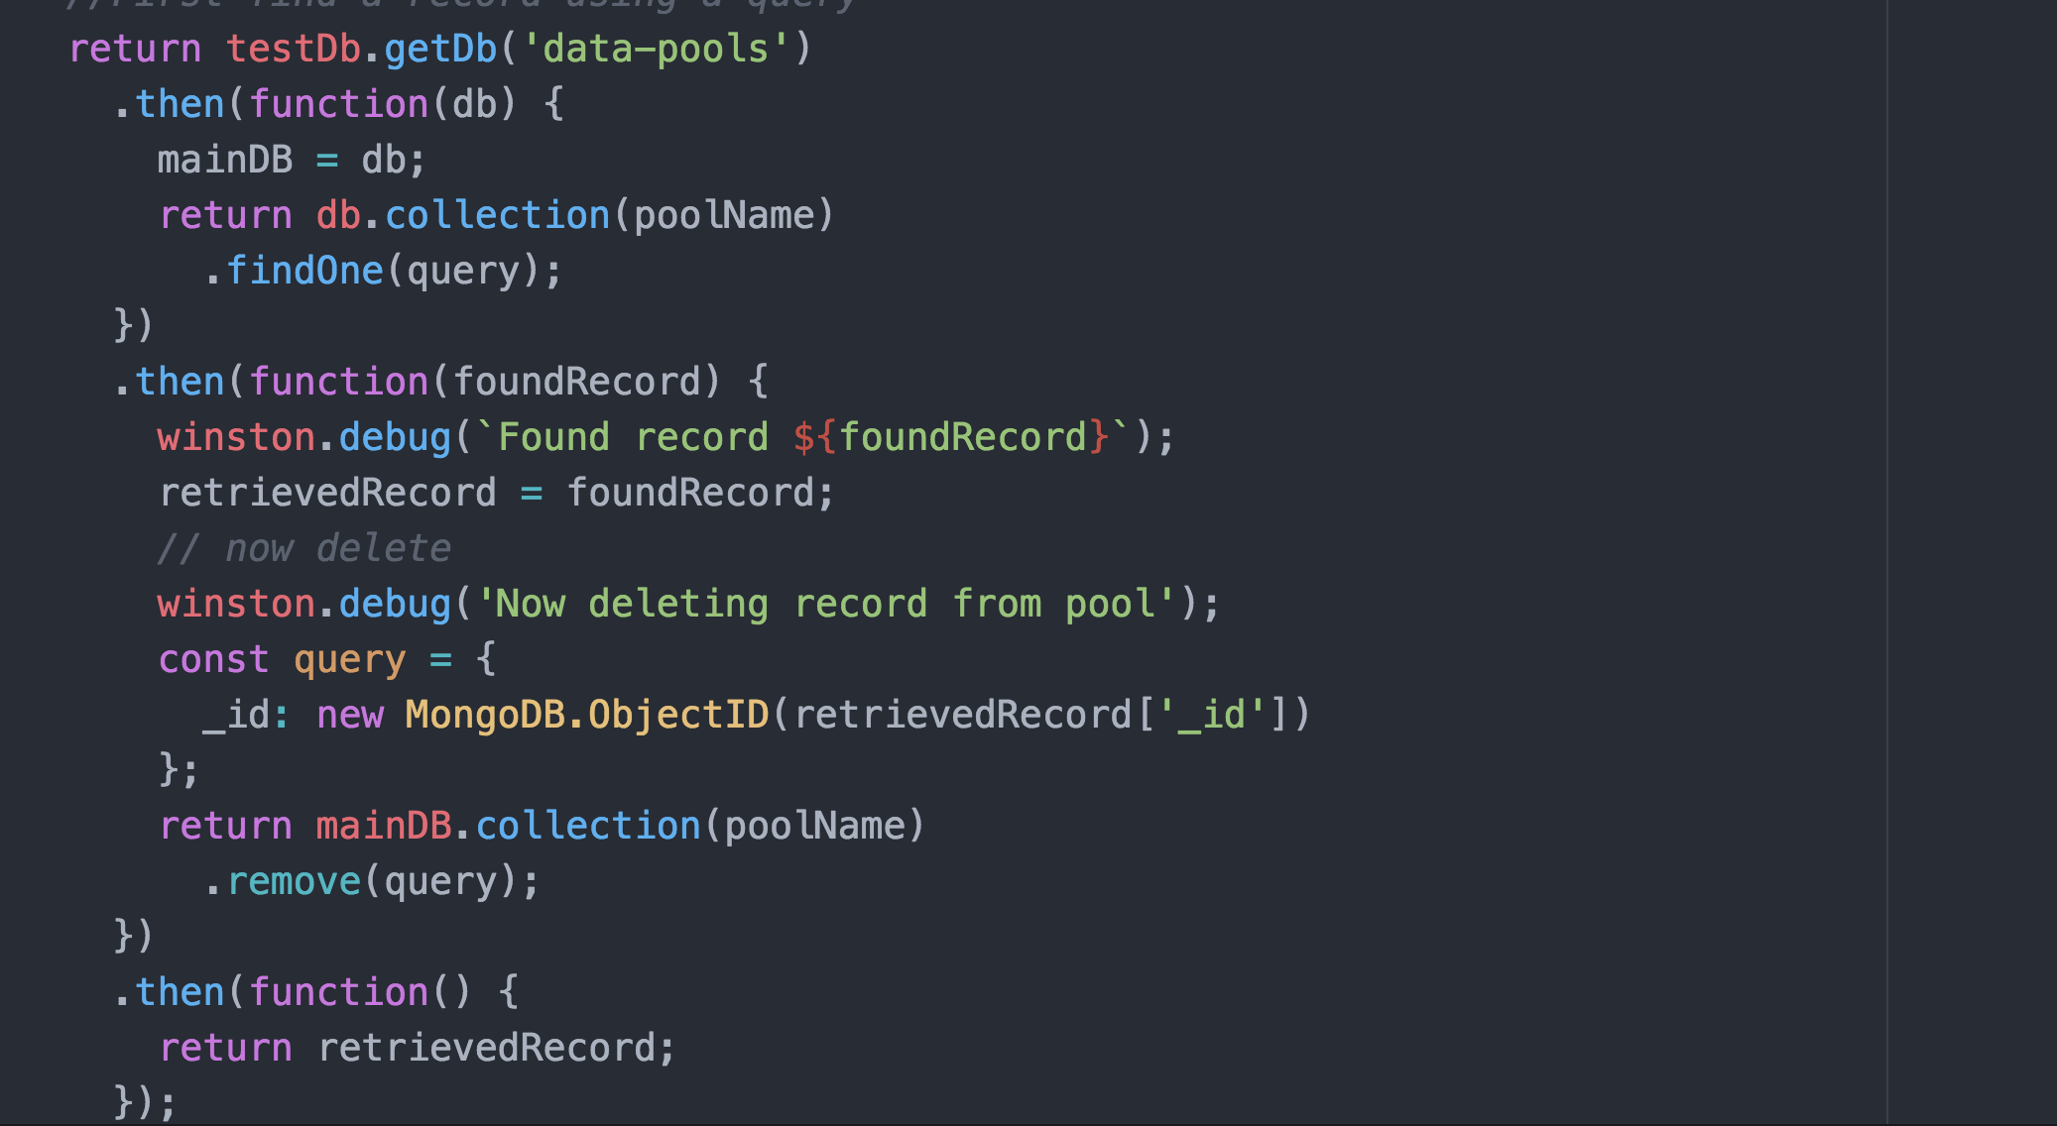
Simplify DB access cont…
Mongo interaction set up to pull a record and delete it when done

Slide 32
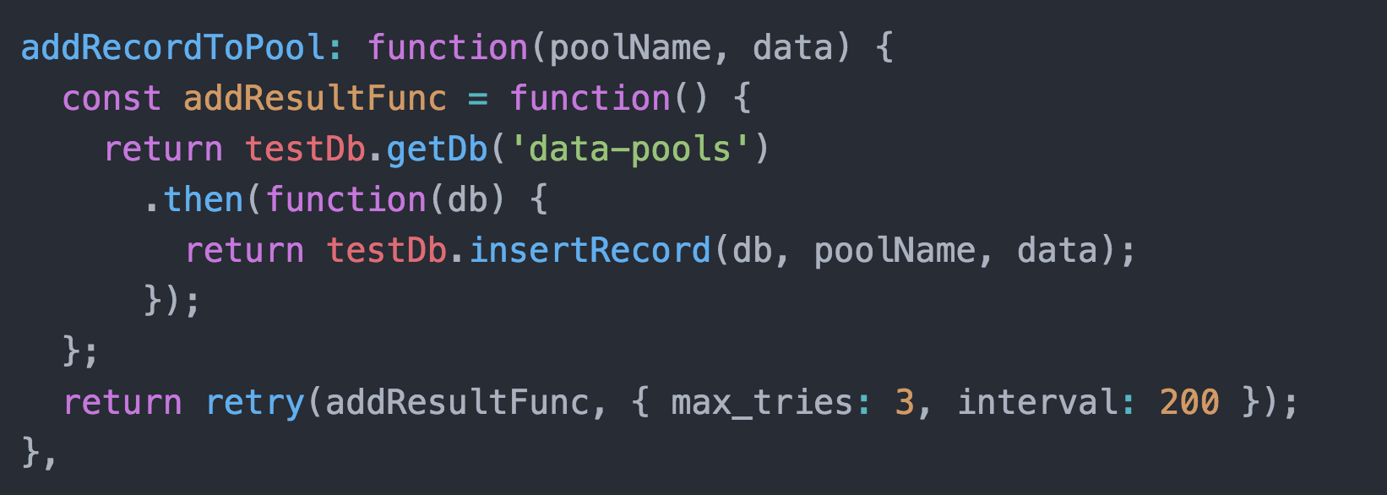
Simplify DB access cont…
Once server is connected at start up write quick methods to interact with DB from a data pooling perspective
Checkout ./server/lib/poolsDB.js for implementation of ’popping’ a staged data off of the queue

Slide 33
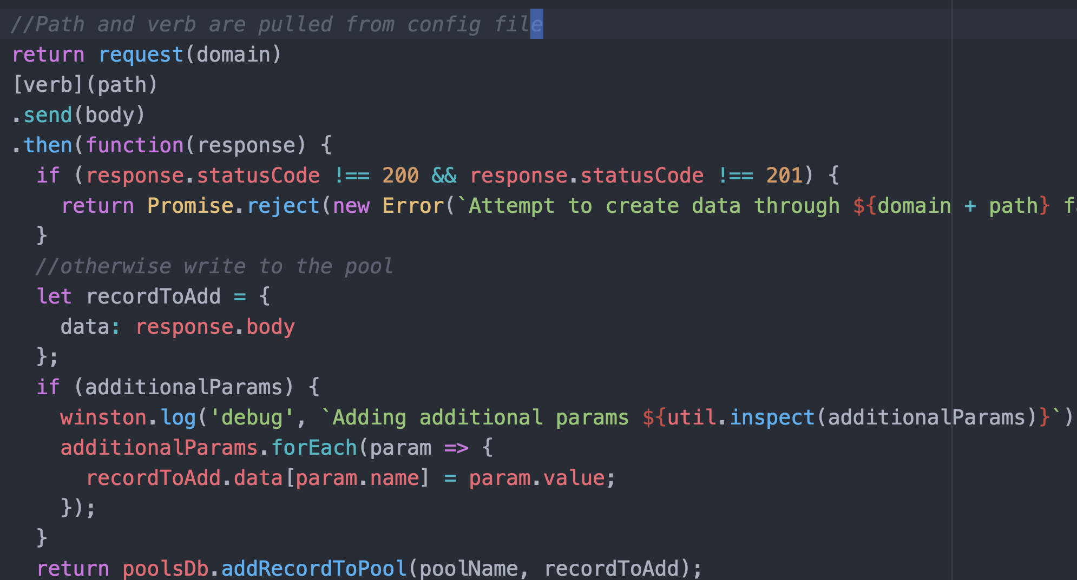
Creating something from our pool config file
We pull the verb & url from the pools config file, execute it and throw the results if its successful in mongo

Slide 34
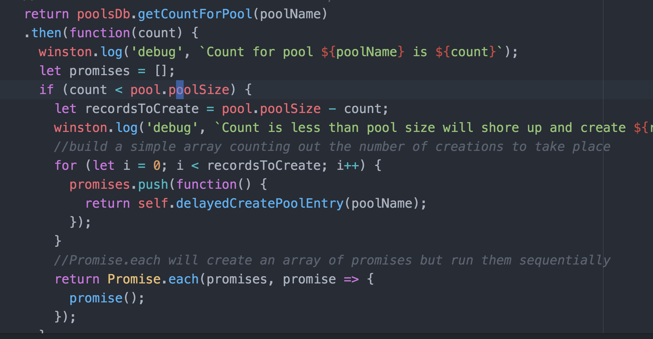
Create our ’shore-up’ method
A simple inefficient method will handle retrieving and replacing pool entries

Slide 35
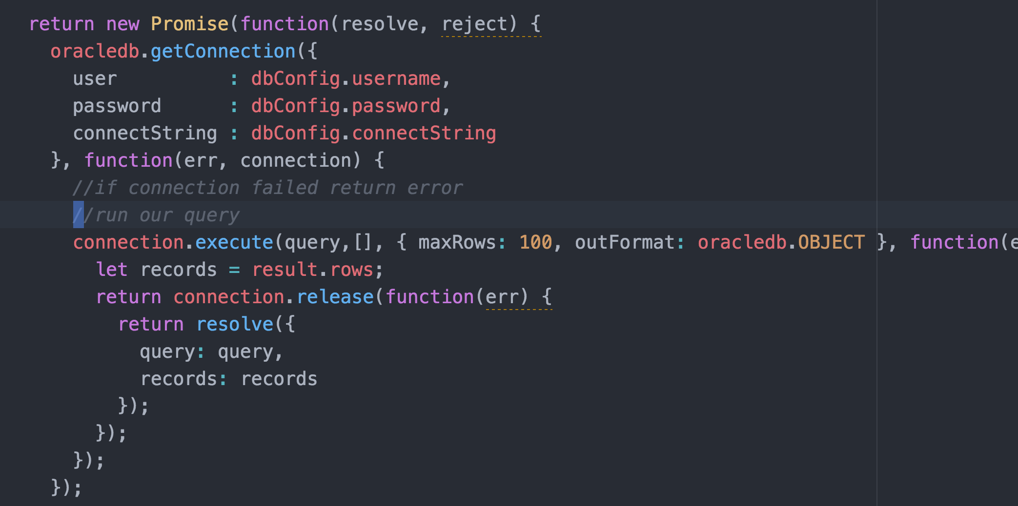
Connect to your companies database
Oracle helper to run a query (simplified without error handling)

Slide 36
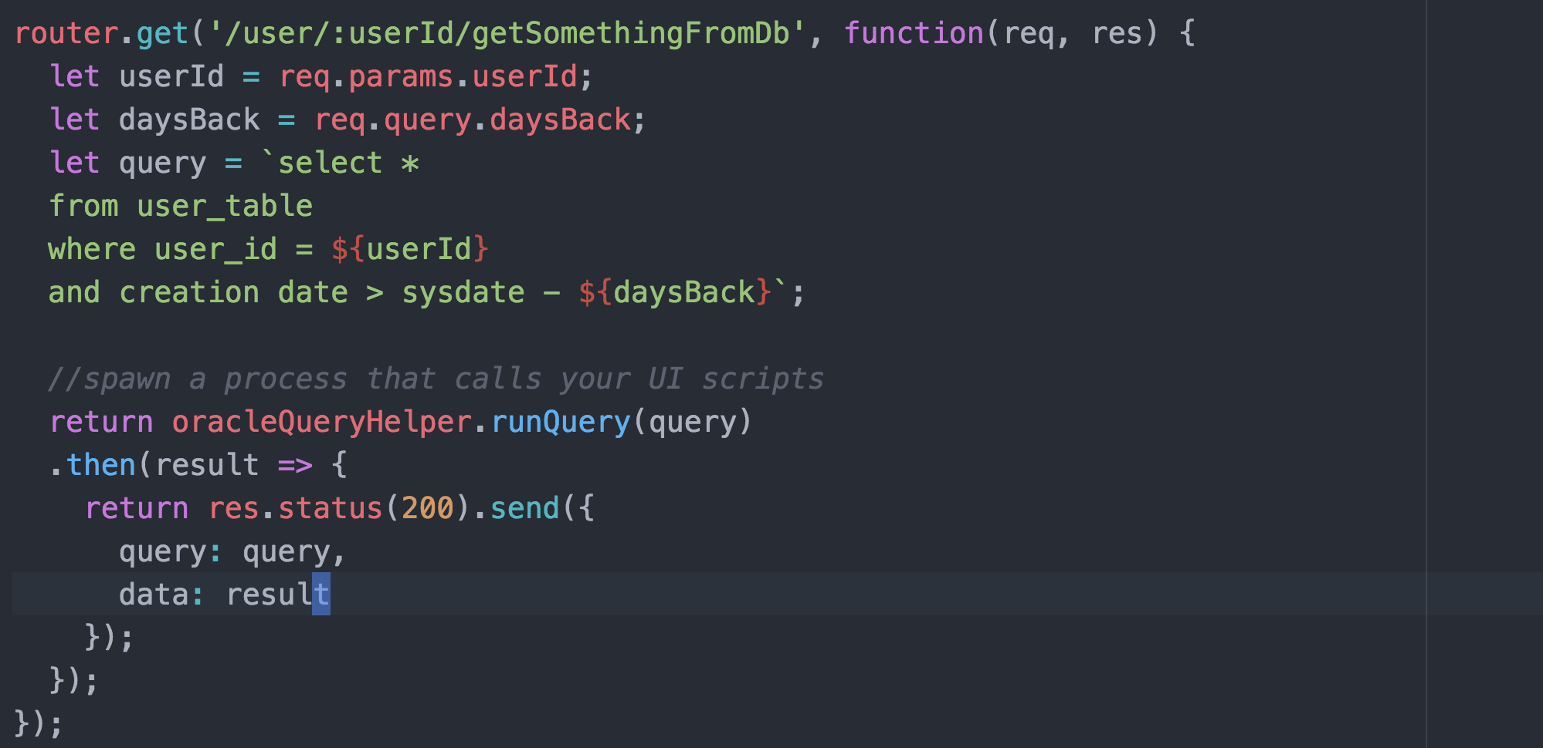
Create endpoint to query DB for you
You can get required information for a query from parameters to your endpoint and build and execute the query for them.

Slide 37
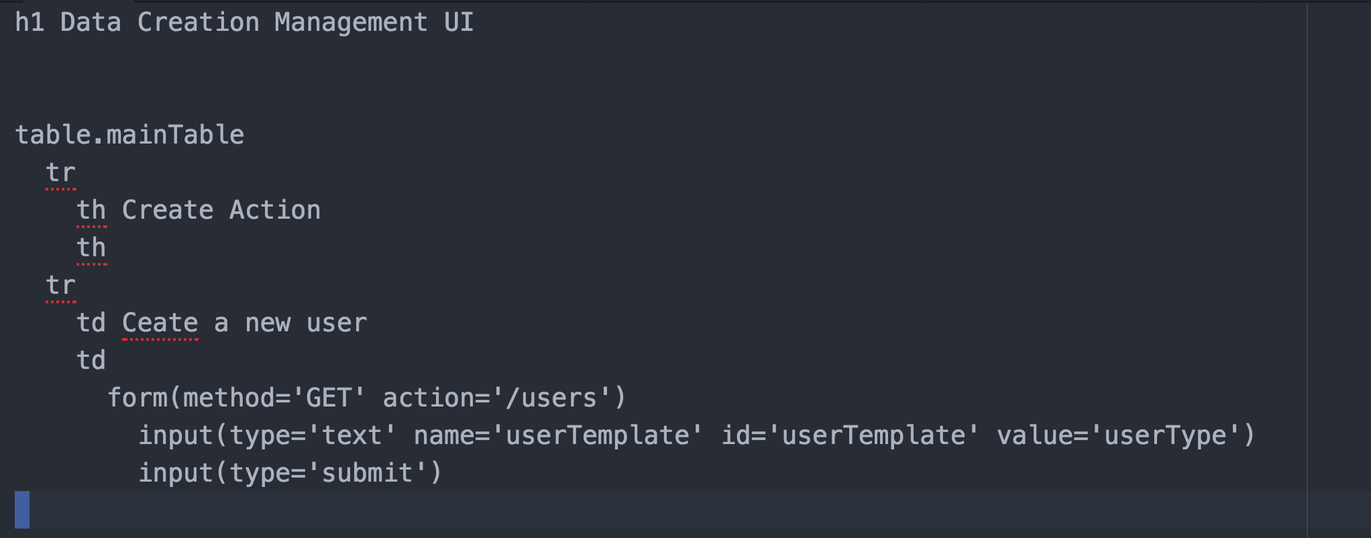
Add a simple UI to make data creation/pooling even easier
Simple forms are all that’s needed and crazy easy to implement

Slide 38
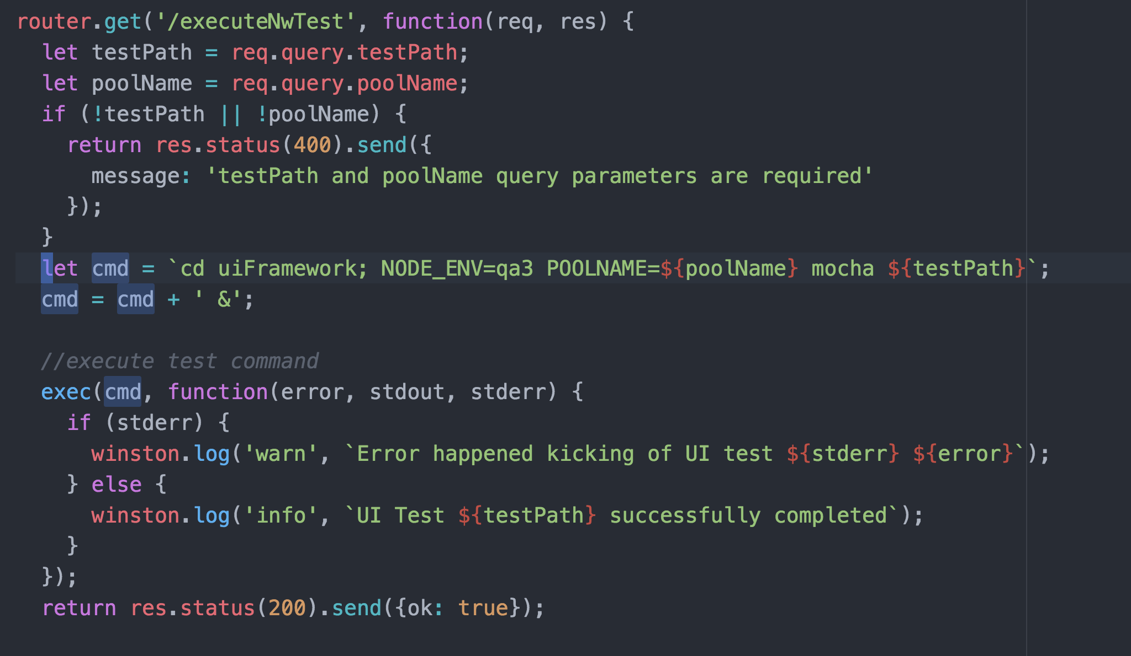
Finally using your UI scripts to create data
You just need a new endpoint that will kick off the UI test on the server

Slide 39
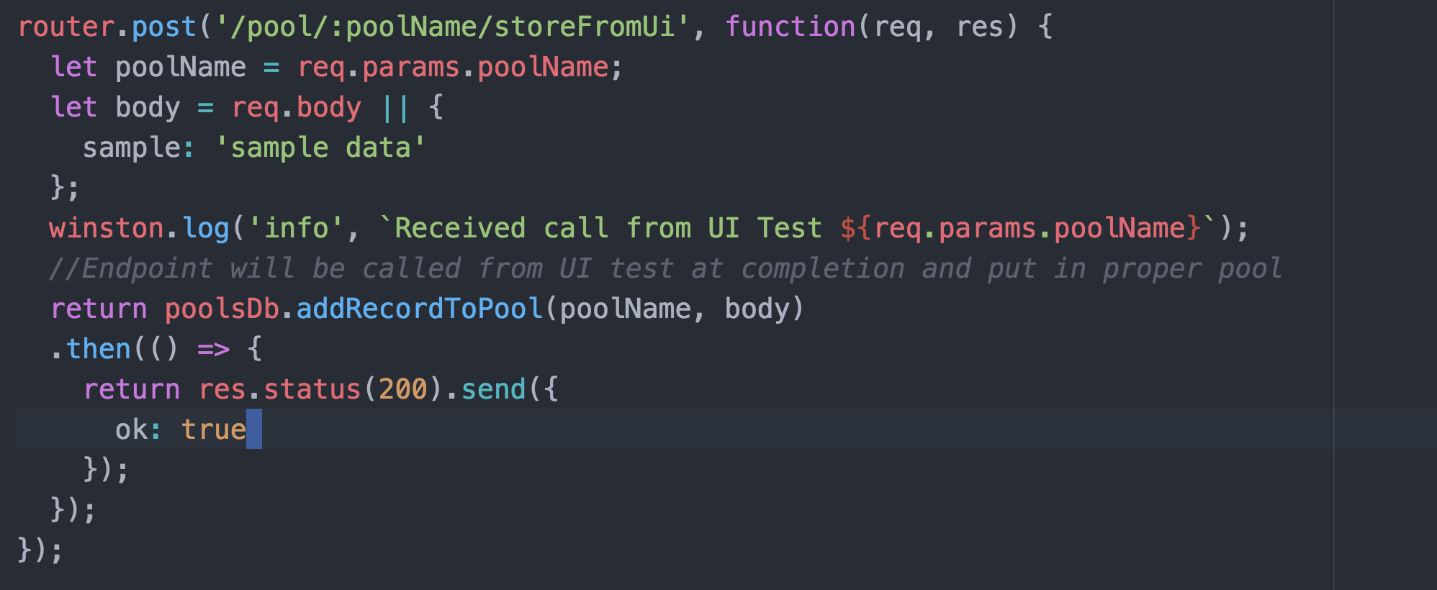
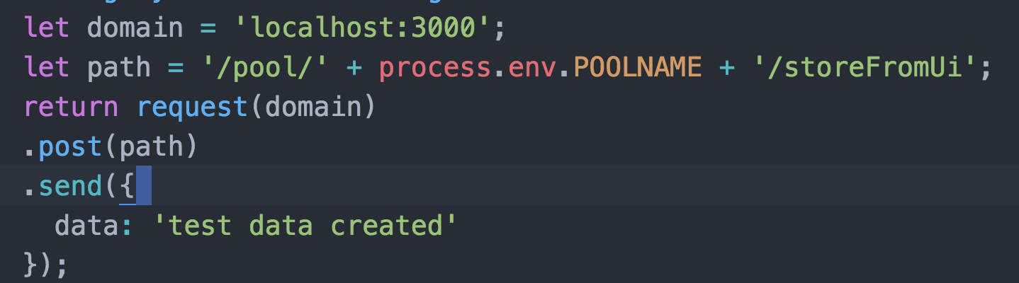
UI script data creation cont …
Then you need an endpoint for the UI test to call back into
And add a line in your test to call when finished with the data it created

Slide 40
Throw in a little more glue and you are set
Glue
A delete endpoint to make cleaning out the pool easier
Some additional bookkeeping methods to support CRUD
Check it all out here
https://github.com/mustarddemon/microservice-demo

Slide 41

Conclusion
Thanks for hanging in there
Slide deck is available
Demo microservice is public and relatively easy to configure for your own stuff
Be the automation engineer to break the trend

